Slide 1
INTRODUCTION
Data
Information
Database
DBMS
Table/relation
Oracle
SQL

Slide 2
What is SQL?
SQL is structured Query Language which is a computer language for storing, manipulating and retrieving data stored in relational database.
SQL is the standard language for Relation Database System. All relational database management systems like MySQL, MS Access, Oracle, Sybase, Informix and SQL Server uses SQL as standard database language.

Slide 3
SQL Components
DDL– create table/rename/alter/drop/ truncate
DML—insert/update/delete
DCL---grant/revoke
TCL---commit/rollback
DQL--Select

Slide 4
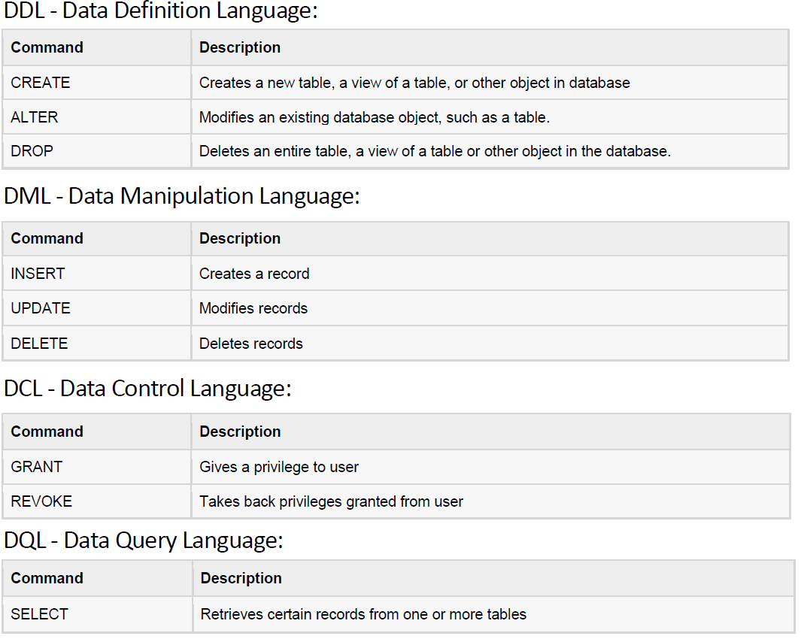

Slide 5
Basic data types
Char
Varchar(size)/varchar2
Date
Number
Long
Raw/long raw

Slide 6
Create Command
This command is used to create/generate new tables.
Syntax
  CREATE TABLE table name
  (column name datatype(size), column name datatype(size) --- );
Example
  CREATE TABLE Student
  (std_name varchar2(20), father_name varchar2(20), DOB number(10), address varchar2(20));

Slide 7
Insert Command
This command is used to insert rows into the table containing already defined columns.
Syntax
INSERT INTO table name
  (column name, column name, --- )
  VALUES (expression, expression, ---);
Example
INSERT INTO Student
(std_name, father_name, DOB, address)
VALUES ('Abid', 'Ibrahim', 1984, 'KARAK');

Slide 8
Select Command
This command is used for viewing/retrieving of data from table.
Syntax
  SELECT column name, column name, ---
  FROM table name;
Examples
Retrieving student names and father names from student
  SELECT std_name , father_name FROM Student;

Slide 9
Retrieving all records from student
  SELECT * FROM Student;
Selected columns and all rows
  SELECT (std_name, father_name)
  FROM Student;
Selected rows and all columns
  SELECT * FROM Student where DOB=1984;
Selected columns and selected rows
  SELECT std_name, DOB FROM Student where address=‘KARAK’;
Elimination of Duplicates from Select
  SELECT DISTINCT * FROM Student;

Slide 10
Delete Command
This is used to delete specified row from table.
Syntax
DELETE FROM table name;
Examples
Removing all rows from table student
DELETE FROM Student;
Removing all rows from table student
DELETE FROM Student where address=‘KARAK’;

Slide 11
Alter Command
This is used to change description of a column or add an extra column.
Syntax
  ALTER TABLE table name
  ADD (new column name data type (size), new column name data type (size) ---);
Example
  ALTER TABLE Student
  ADD (marks number(3), gender varchar(2));
  ALTER TABLE Student
  MODIFY (address char(20));

Slide 12
Update Command
This is used for changing one or more values in the row of the table.
Syntax
UPDATE table name SET (column name = expression, column name = expression ---);
Example
UPDATE Student SET marks = 5;
UPDATE Student SET marks = 5 where std_name=‘Abid’;

Slide 13
Rename Command
This is used to rename old/existing table.
Example
ALTER table Student RENAME TO PersonalData ;

Slide 14
Drop Command
This is used to remove table from database.
Syntax
DROP TABLE table name;
Example
DROP Table Student;

Slide 15
Describe Command
This command is used to display column names, data types and attributes connected to the database.
Syntax
DESCRIBE table name;
Example
DESCRIBE Student;

Slide 16
SQL Components: DDL/DML/DCL/TCL
create table emp
(
rno number(5),
name varchar2(15),
marks number(5));
…………………………
update emp set marks=’40’ where marks=’55’;
………………………….
update emp set marks=’21’;
……………………………….
select rowid from emp;
--------------------------------------
delete from emp where marks=‘21';
……………………………………
delete from emp where rowid='AAADVTAABAAAKS6AAC';
……………………………………

Slide 17
Integrity constraints
Primary key
Foreign key
Check
Not null
Unique
Default

Slide 18
NOT NULL Constraint: Ensures that a column cannot have NULL value.
DEFAULT Constraint : Provides a default value for a column when none is specified.
UNIQUE Constraint: Ensures that all values in a column are different.
PRIMARY Key: Uniquely identified each rows/records in a database table.
FOREIGN Key: Uniquely identified a rows/records in any another database table.
CHECK Constraint: The CHECK constraint ensures that all values in a column satisfy certain conditions.

Slide 19
Primary key
alter table emp
add primary key(rno);
Default
alter table emp
modify name default 'aaa'

Slide 20
Check
alter table emp
add check(rno>5);
Foreign key
Alter table emp add foreign key (dno) references dept(depno);

Slide 21
Unique
ALTER TABLE emp
ADD UNIQUE (name);
NOT NULL
Alter table emp
modify esal number(5) not null;

Slide 22
Joins
1. The purpose of a join is to combine the data across tables.
2. A join is actually performed by the where clause which combines the specified rows of tables.
3. If a join involves in more than two tables then oracle joins first two tables based on the joins condition and then compares the result with the next table and so on.

Slide 23
Types of Joins
Natural join
Inner join
Outer join
left outer join
right outer join
full outer join
Self join
Cross join (Cartesian product)
Equi & Non Equi joins

Slide 24
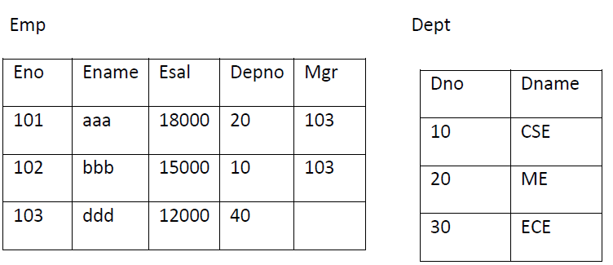
Assume that we have the following tables.

Slide 25
1. EQUI JOIN
A join which contains an equal to ‘=’ operator in the joins condition.
Ex: SQL> select eno,ename,esal,dname from emp ,dept where emp.deptno=dept.deptno;
2. NON-EQUI JOIN
A join which contains an operator other than equal to ‘=’ in the joins condition.
Ex: SQL> select eno,ename,esal,dname from emp ,dept where emp.deptno>dept.deptno;

Slide 26
3. SELF JOIN
Joining the table itself is called self join.
Select a.name “teacher”, c.name “hod” from teacher a, teacher c where a.hod=c.id
ID | NAME | HOD
1 | M | 2
2 | N
3 | O | 4
4 | P

Slide 27
4. NATURAL JOIN
Natural join compares all the common columns.
Ex: SQL> select eno,ename,dname,loc from emp natural join dept;
5. CROSS JOIN
This will gives the cross product.
Ex: SQL> select empno,ename,esal,dname,loc from emp cross join dept;

Slide 28
6. OUTER JOIN
Outer join gives the non-matching records along with matching records.
LEFT OUTER JOIN
This will display the all matching records and the records which are in left hand side table those that are not in right hand side table.
Ex: SQL> select eno,ename,job,dname,loc from emp left outer join dept on(emp.depno=dept.dno);
Or
SQL> select eno,ename,job,dname,loc from emp ,dept where emp.depno=dept.dno(+);

Slide 29
RIGHT OUTER JOIN
This will display the all matching records and the records which are in right hand side table those that are not in left hand side table.
Ex:
SQL> select empno,ename,job,dname,loc from emp right outer join dept on(emp.depno=dept.dno);
Or
SQL> select empno,ename,job,dname,loc from emp ,dept where emp.depno(+) = dept.dno;
FULL OUTER JOIN
This will display the all matching records and the non-matching records from both tables.
Ex:
SQL> select empno,ename,job,dname,loc from emp full outer join dept on(emp.depno=dept.dno);

Slide 30
7. INNER JOIN
This will display all the records that have matched.
Ex: SQL> select empno,ename,job,dname,loc from emp inner join dept using(deptno);

Slide 31
Operators and clauses
IN
OR
AND
Between
Like
Distinct
Rowid
Order by

Slide 32
Like operator is used for string or pattern matching
% character is used to match any string of any length.
_ character to match a single character.

Slide 33
Aggregate functions
These functions operate on the multiset of values of a column of a relation, and return a value.
avg: average value
min: minimum value
max: maximum value
sum: sum of values
count: number of values

Slide 34
Find the average account balance at the Perryridge branch.
select avg(balance)
From account
where branch-name = ‘Perryridge’
Find the number of depositors in the bank.
  select count (*)
  from customer
Find the number of tuples in the customer relation.
select count (distinct customer-name)
from depositor

Slide 35
Group By and Having
Find the names of all branches where the average account balance is more than $1,200.
  Select branch-name, avg(balance)
  From account
  group by branch-name having avg(balance) > 1200
Note: predicates in the having clause are applied after the
formation of groups whereas predicates in the where
clause are applied before forming groups

Slide 36
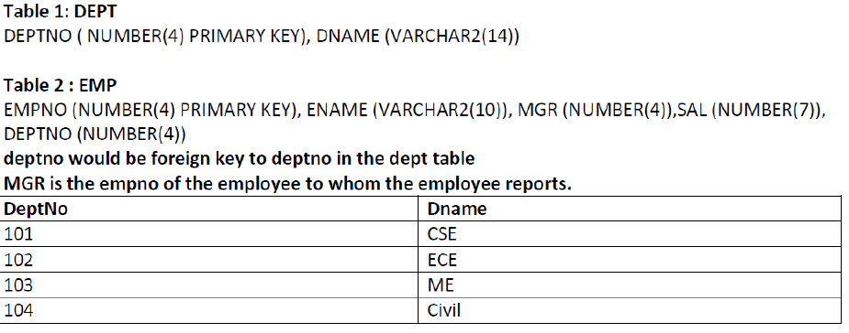
Problems

Slide 37
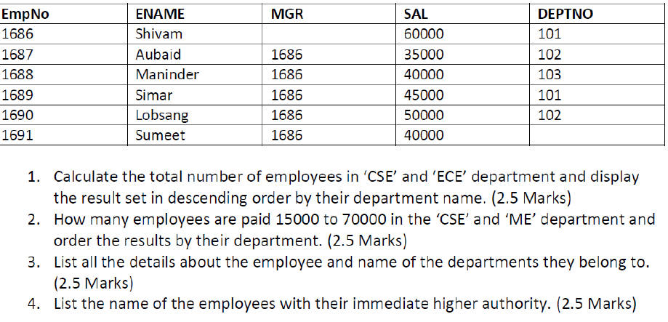

Slide 38
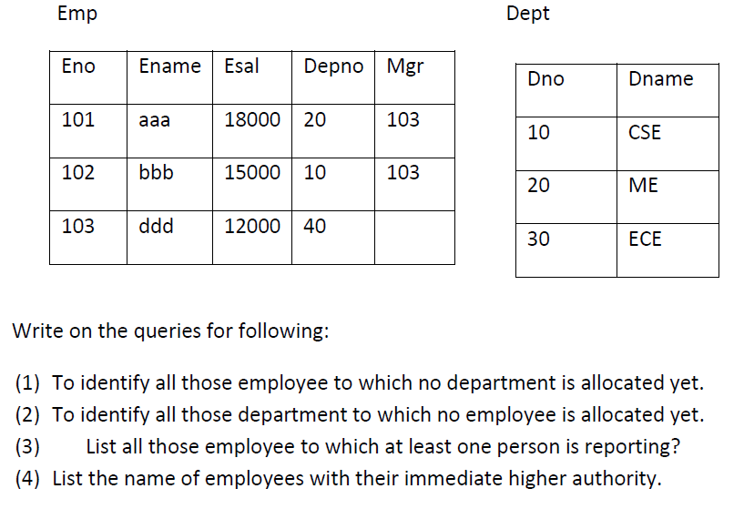

Slide 39
